Slide 1
AIML Assignment 1
By Ashley Bai (P2237871)
(AI)

Slide 2
Table of contents
01
02
Classification: credit_dataset.csv
Regression: housing_dataset.csv

Slide 3
02
Regression
housing_dataset.csv

Slide 4
Background
This is a dataset collected from a property agent.
This dataset contains 545 data points with 8 columns.
The aim of this dataset is to predict the housing price in US based on various factors such as city, house area, No. of Bedrooms and toilets, renovation status, etc, with the use of regression.
Dataset includes:
House ID: Unique house identifier ranging from 0 to 544
City: Which city the house is located
House Area: Size of the house in square meters
No. of Bedrooms: How many bedrooms in the house
No. of Toilets: How many toilets in the house
Stories: The number of stories in the house
Renovation Status: How well the house is renovated
Price: The price of the house in US dollars

Slide 5
02
Regression
housing_dataset.csv

Slide 6
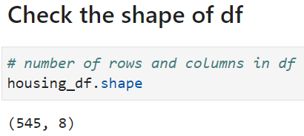
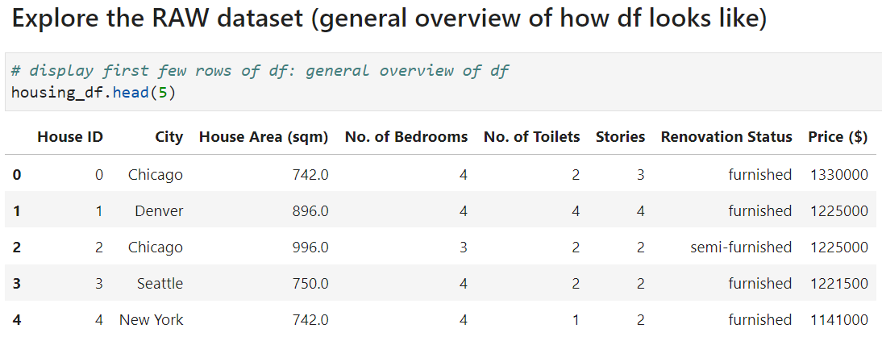
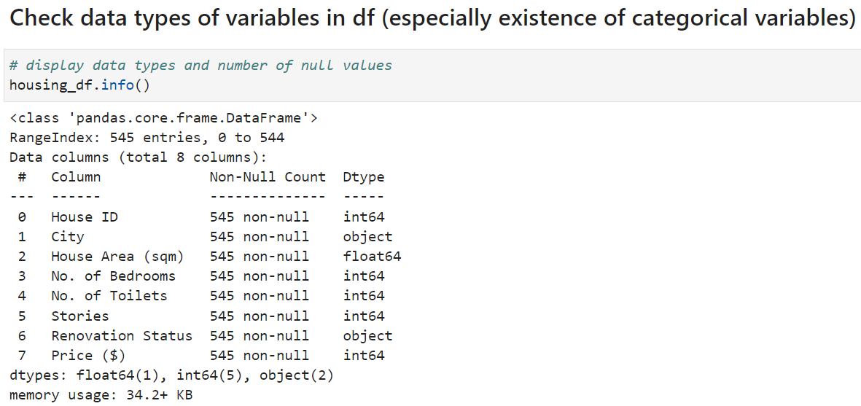
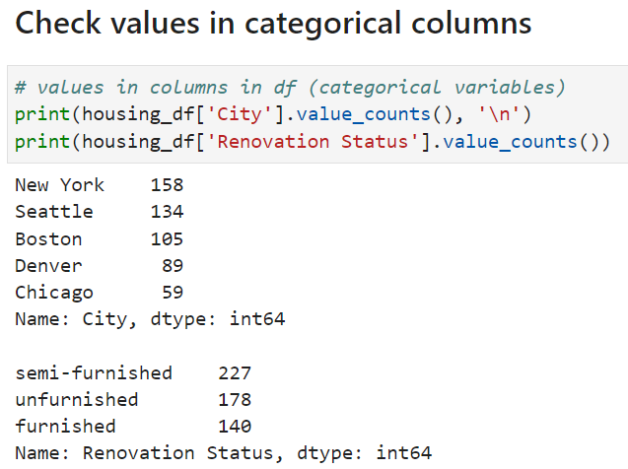
Explanatory Data Analysis (EDA)
Target variable: Price ($)
The dataset contains categorical and numerical columns.
City and Renovation Status are categorical columns.
There are 545 rows and 8 columns in the df.

Slide 7
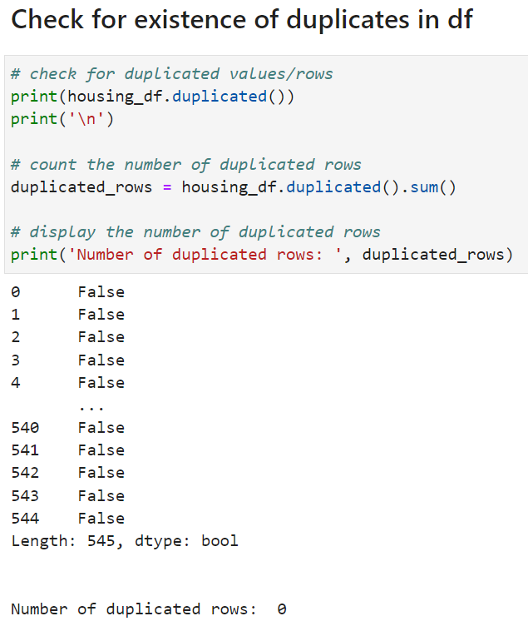
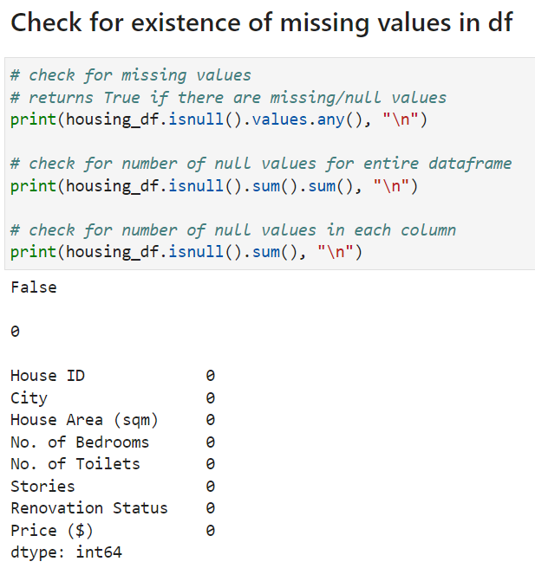
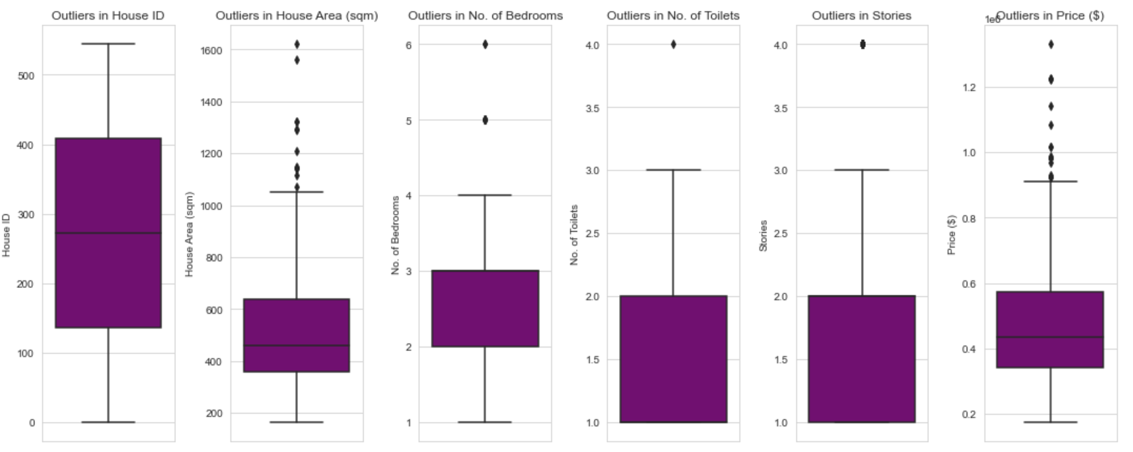
Explanatory Data Analysis (EDA)
There are no duplicate values in df.
There are no missing values in df.
There is presence of outliers in df.

Slide 8
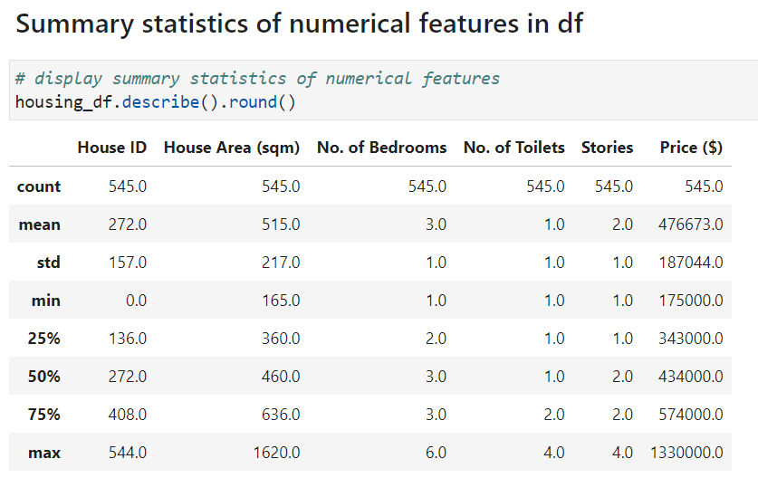
Explanatory Data Analysis (EDA)
There are 545 distinct houses.
The mean size of houses is 515sqm, with mean price of $476,673.
Generally, every house has 1 toilet, 2 stories, and 3 bedrooms.
Standard Deviation of housing prices is quite large, with minimum price being $175,000 and maximum price being $1,330,000.
Target variable has large variability.
This tells us that dataset has outliers.

Slide 9
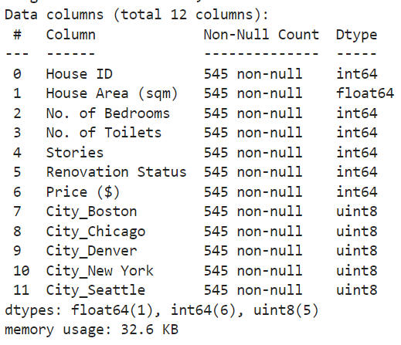
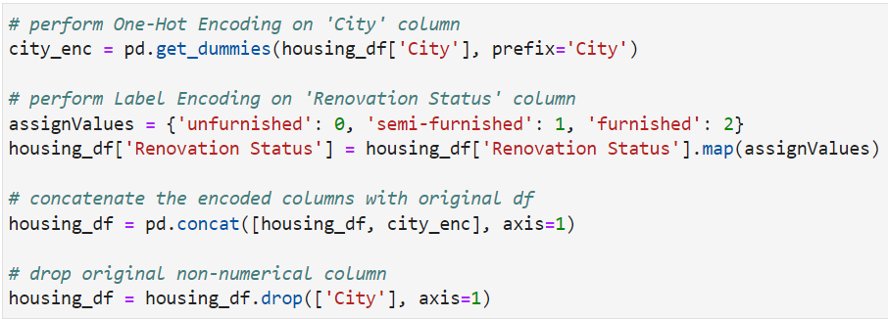
Data Pre-Processing
From EDA, it was found that there were categorical variables.
Since machine-learning models can only work with numerical values, it is important for us to transform categorical variables into numerical ones:
(1) One-Hot Encoding on ‘City’ column
(b) Label-Encoding on ‘Renovation Status’ column (ordinal)
By assigning unique numerical values to each level, quality of house renovation can be shown.

Slide 10
Feature Engineering
(1) BedroomToiletRatio
This Bedroom-to-Toilet Ratio can give an idea of balance between bedroom and bathroom space in a house.
(2) Area per Bathroom
To see how much space in bedrooms.
(3) Area per Toilet
To see how spacious and convenient bathrooms in the house are
All these features may play a crucial role in predicting housing price.

Slide 11
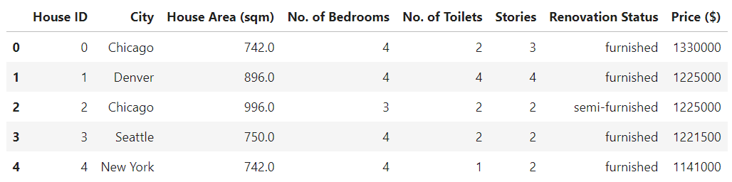
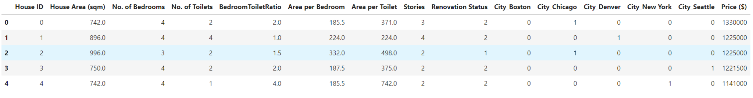
Feature Engineering
Columns are now all numerical.

Slide 12
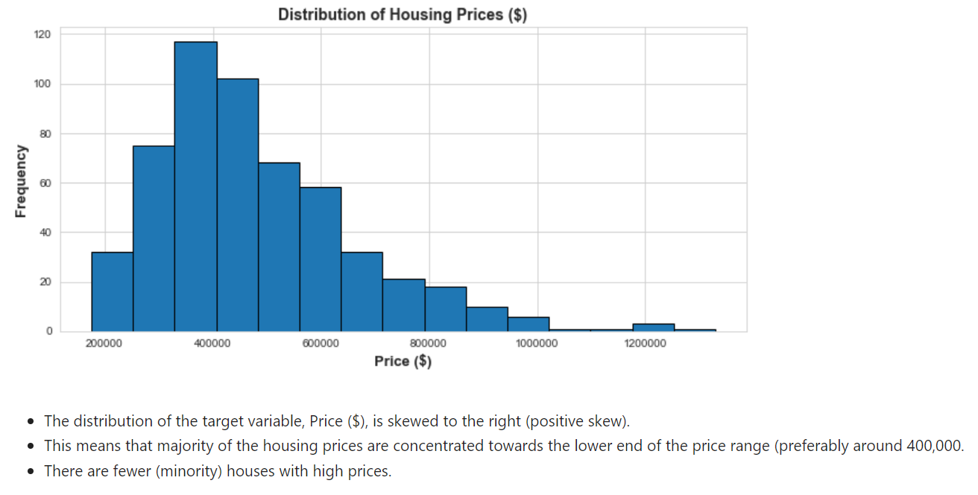
Data Visualization

Slide 13
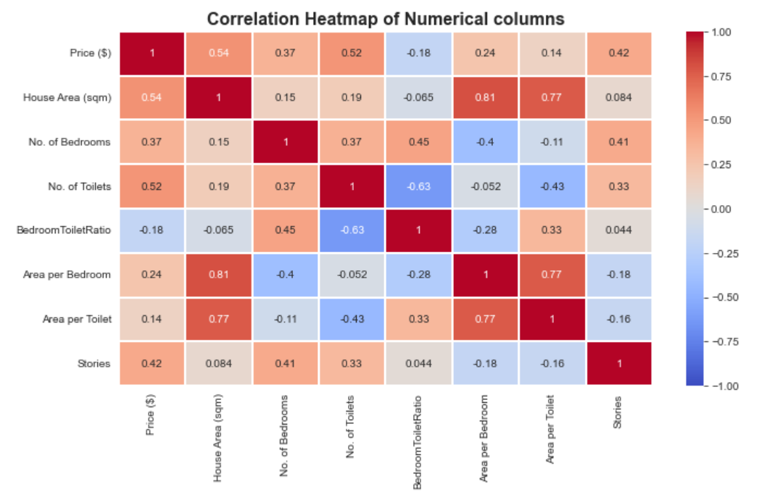
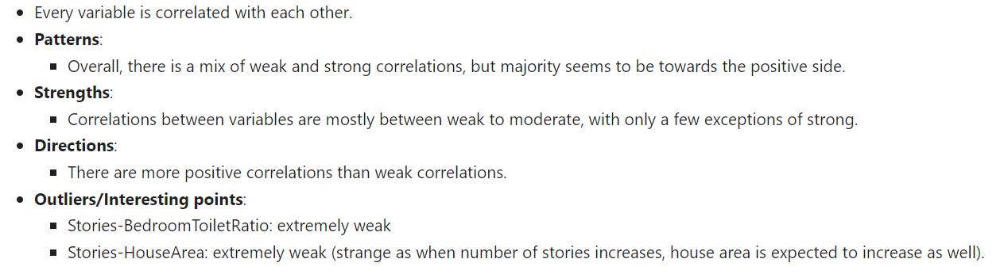

Slide 14
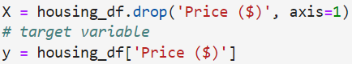
Regression Models
Models Built:
Linear Regression
Decision Tree Regression
Random Forest Regression
Gradient Boosting Regression
Neural Network Regression
Lasso
Ridge

Slide 15
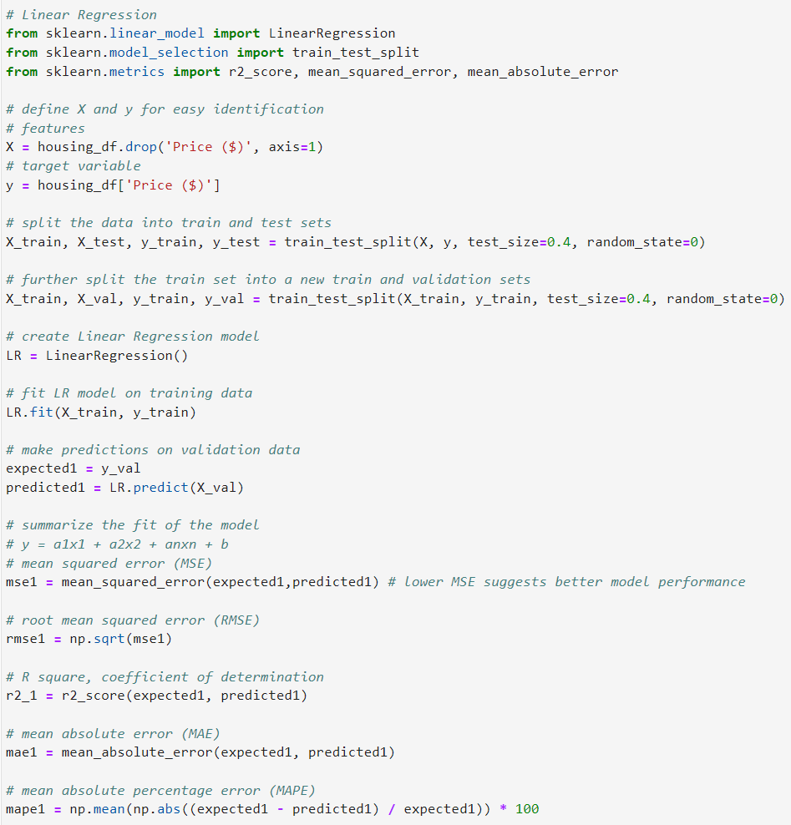
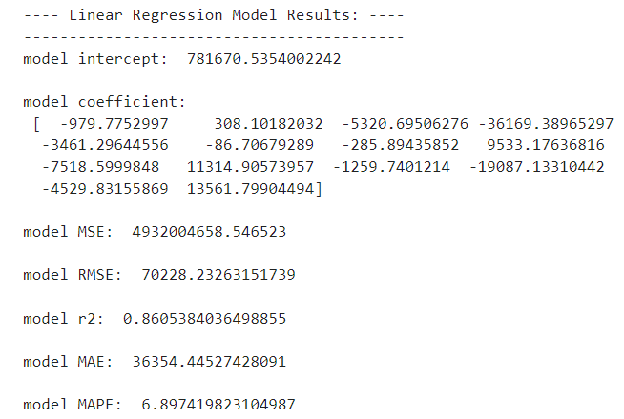
Linear Regression

Slide 16
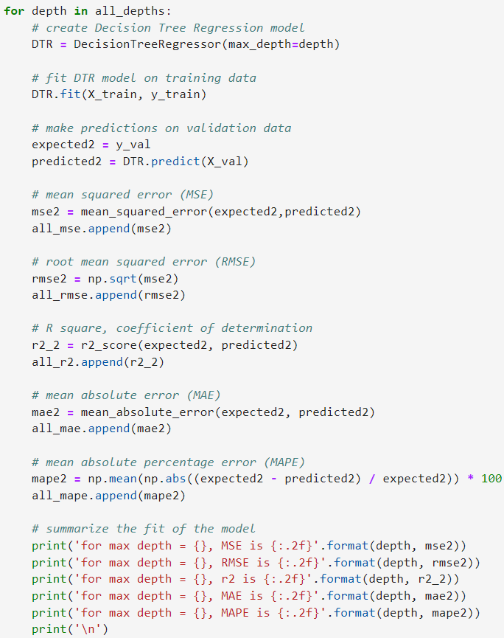
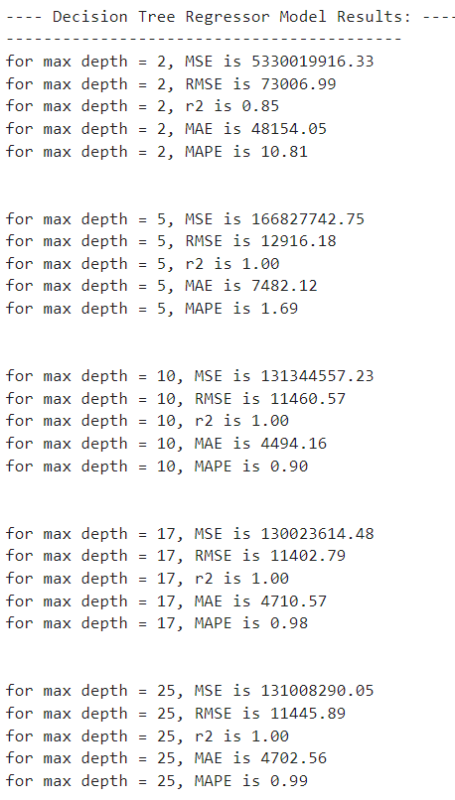
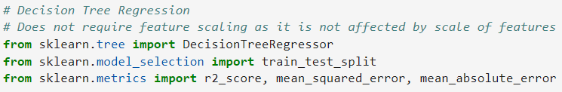
Decision Tree Regression
Find out which is best max_depth value

Slide 17
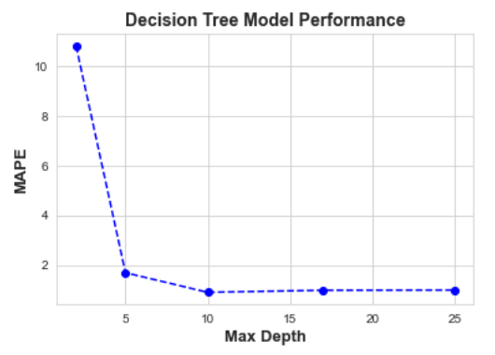
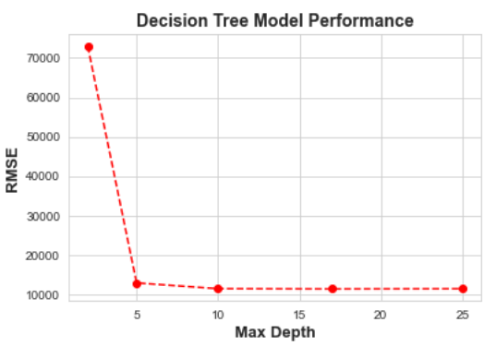
Decision Tree Regression
Find out which is best max_depth value
From graphs of Max_depth against RMSE and MAPE, it is evident that max_depth=10 yields best results.

Slide 18
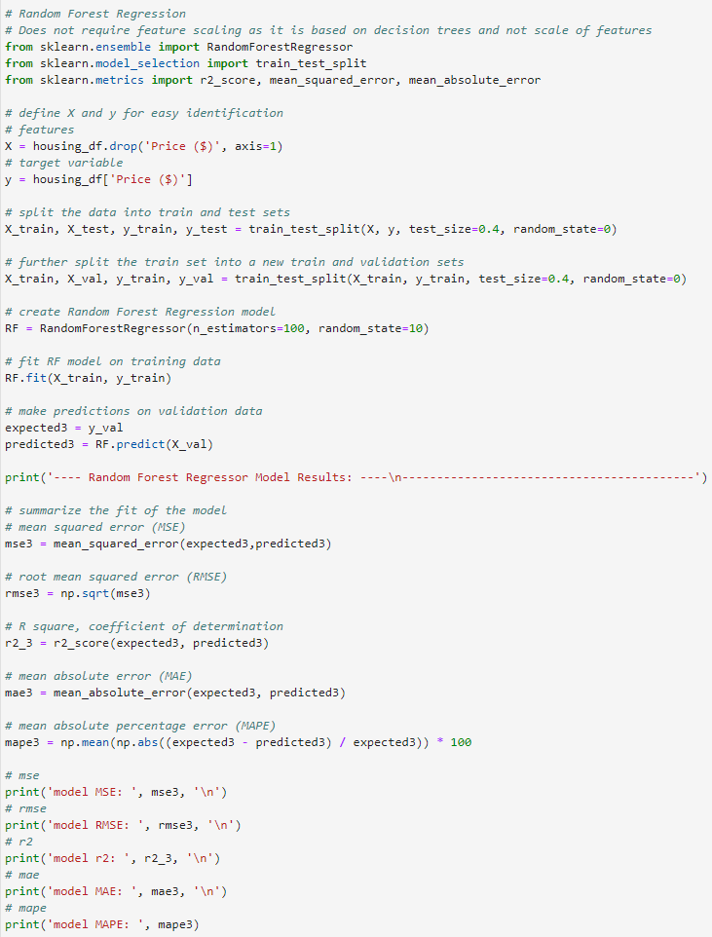
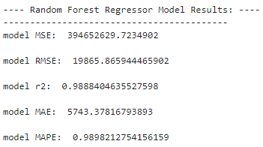
Random Forest Regression

Slide 19
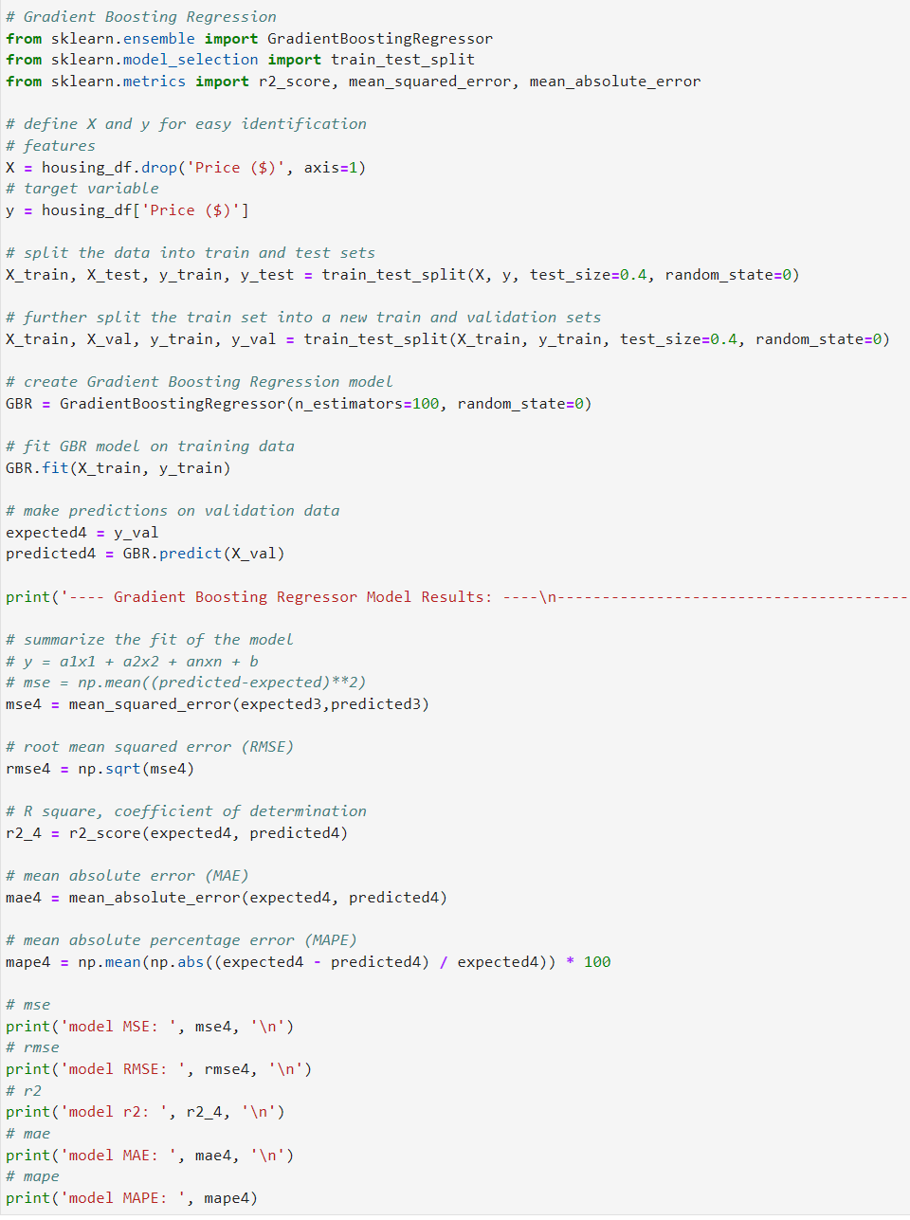
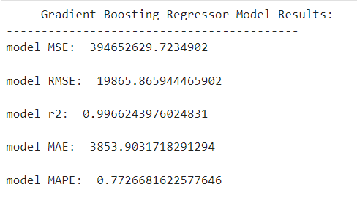
Gradient Boosting Regression

Slide 20
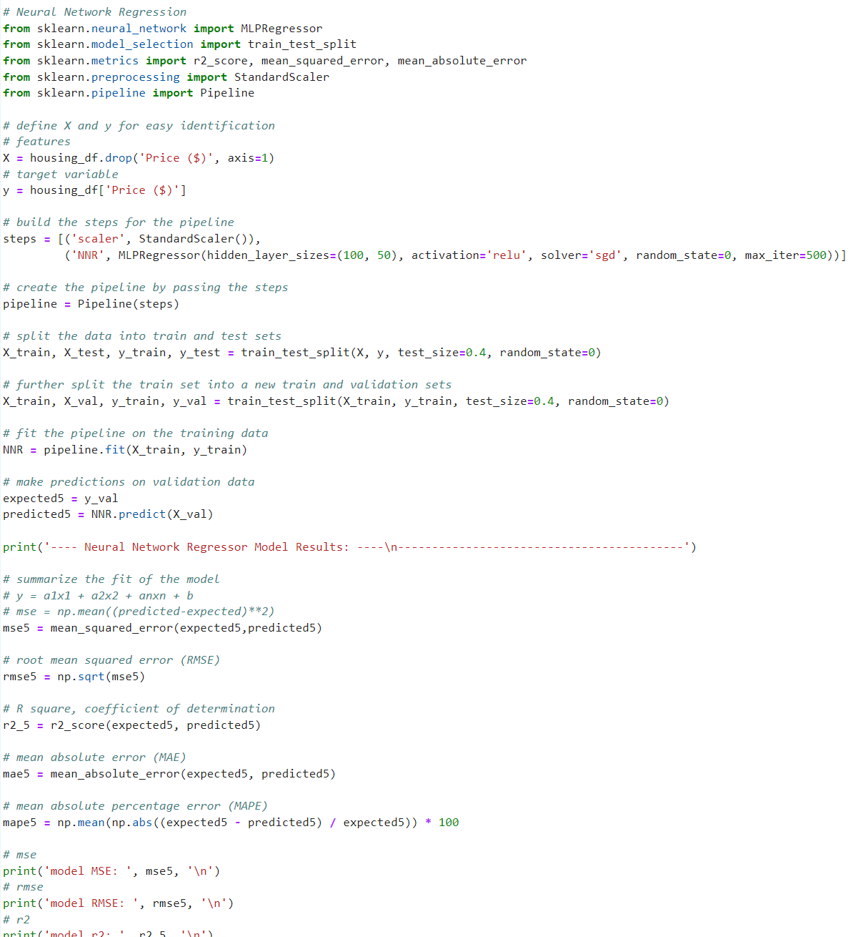
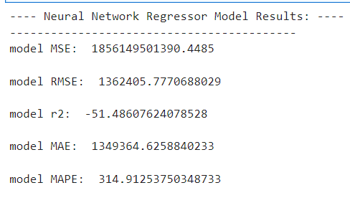
Neural Network Regression

Slide 21
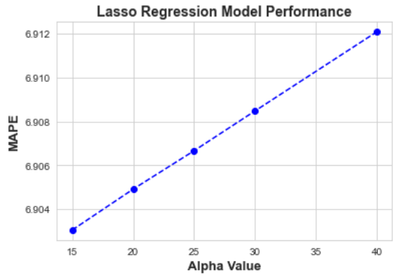
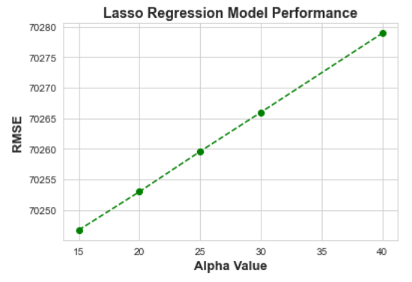
Lasso Regression
Since lower RMSE and MAPE yields best results, alpha=15.0 is chosen as alpha value for lasso.

Slide 22
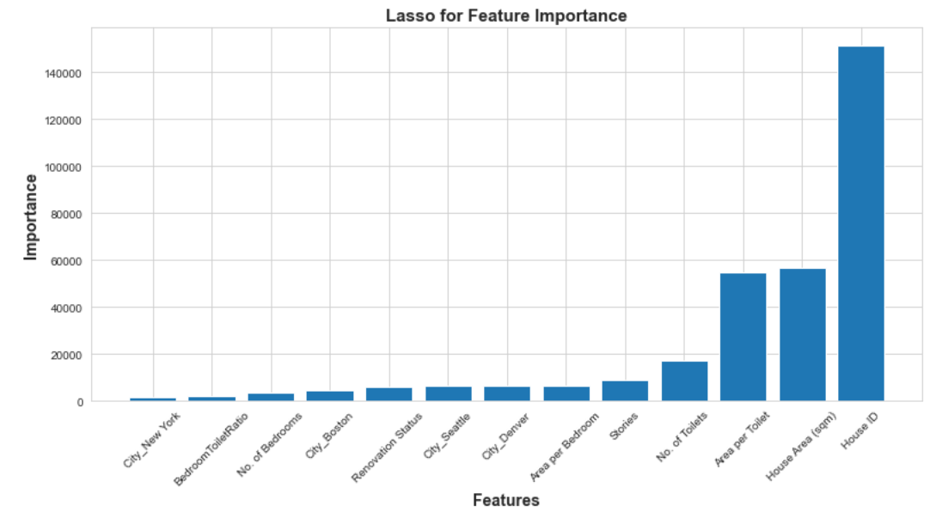
Lasso Regression

Slide 23
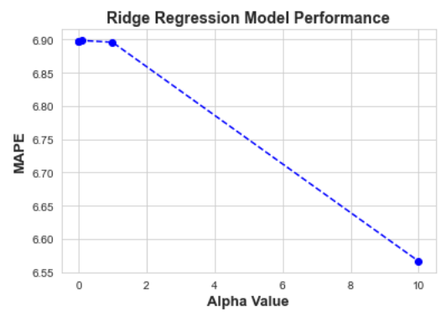
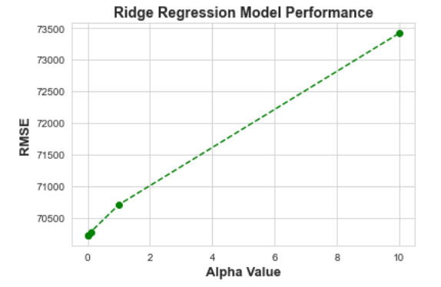
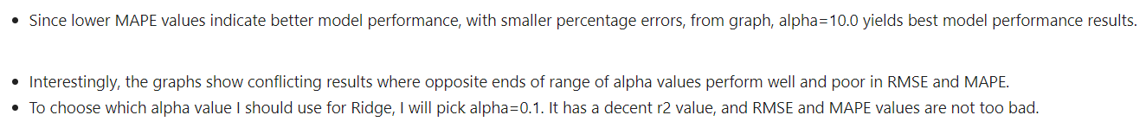
Ridge Regression

Slide 24
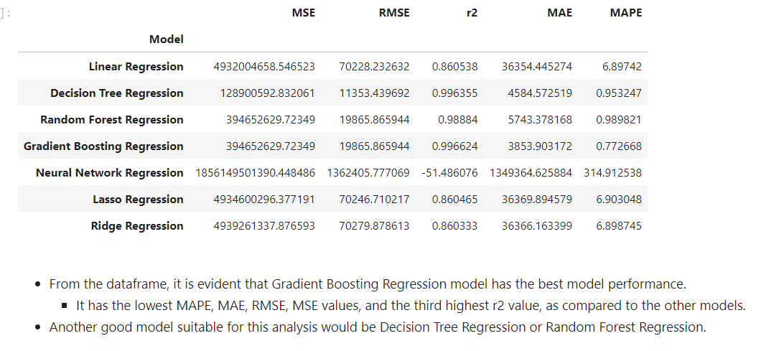
Model Evaluation

Slide 25
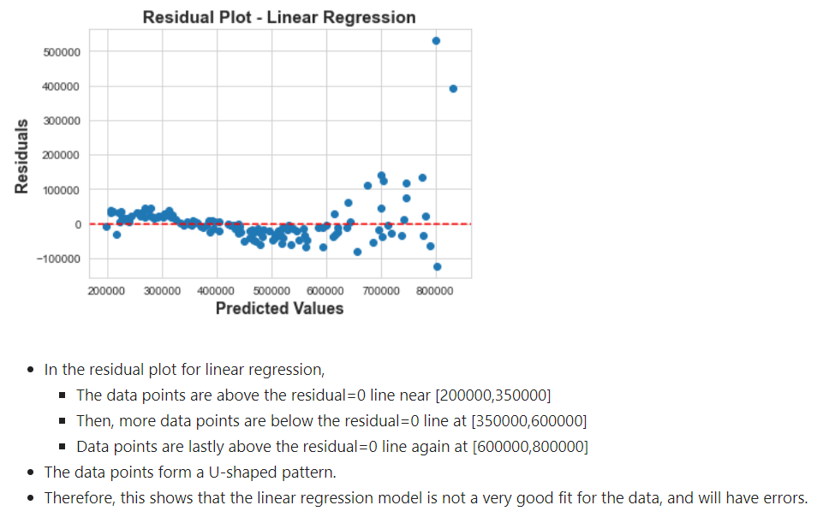
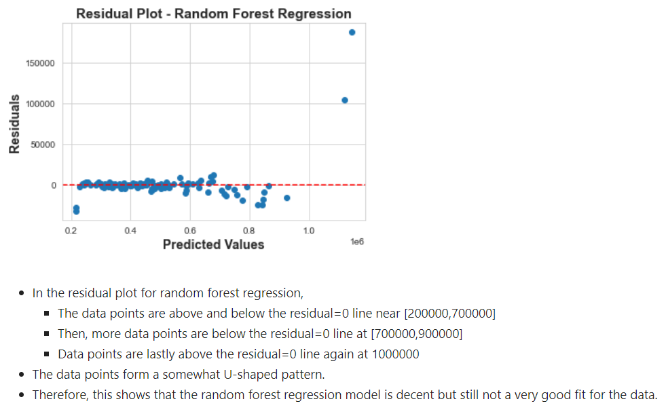
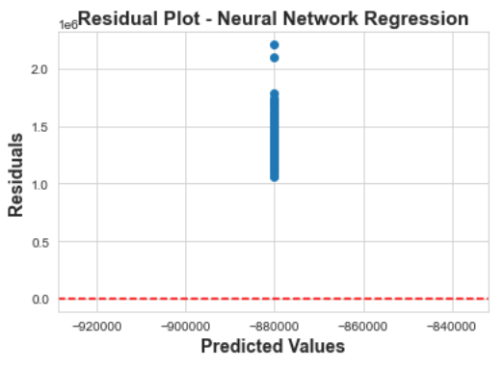
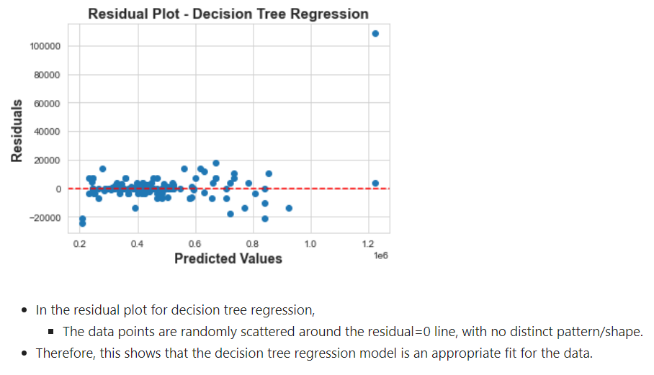
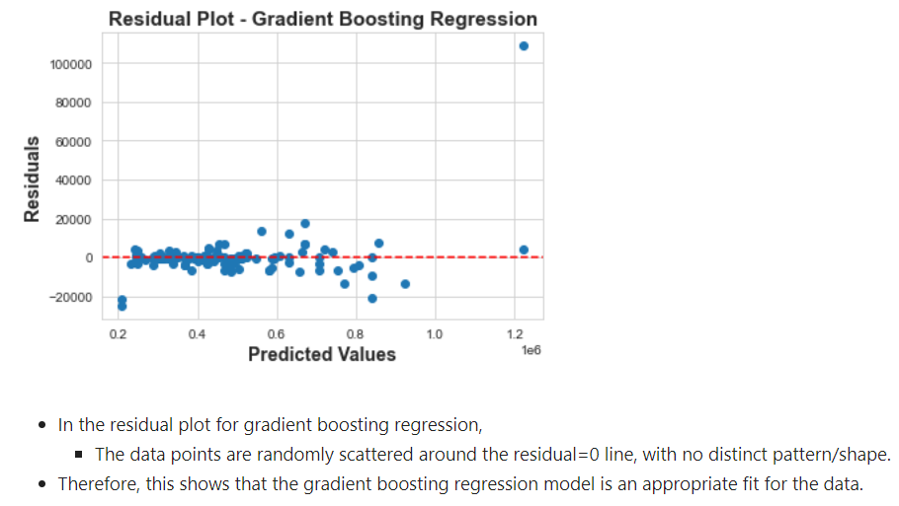
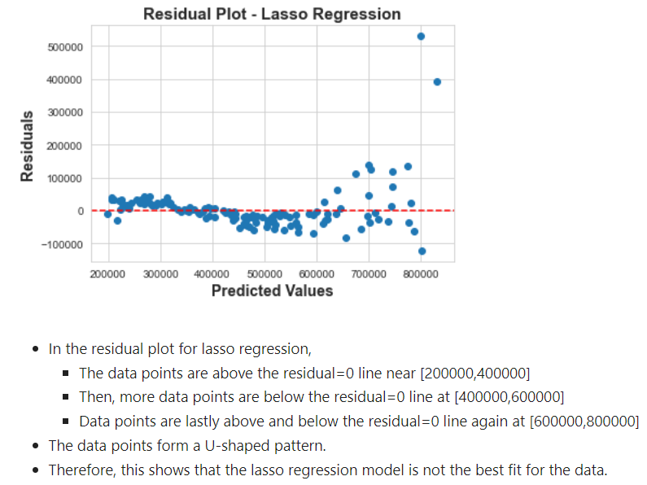
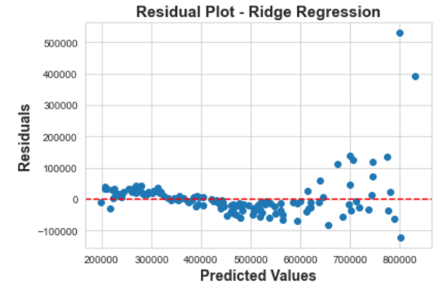

Slide 26
